Slide 1


ReturnGuard
An intelligent, COD-native fraud and return-risk engine built for India's small-to-mid D2C retailers.
Mentor: Thavayee

Slide 2
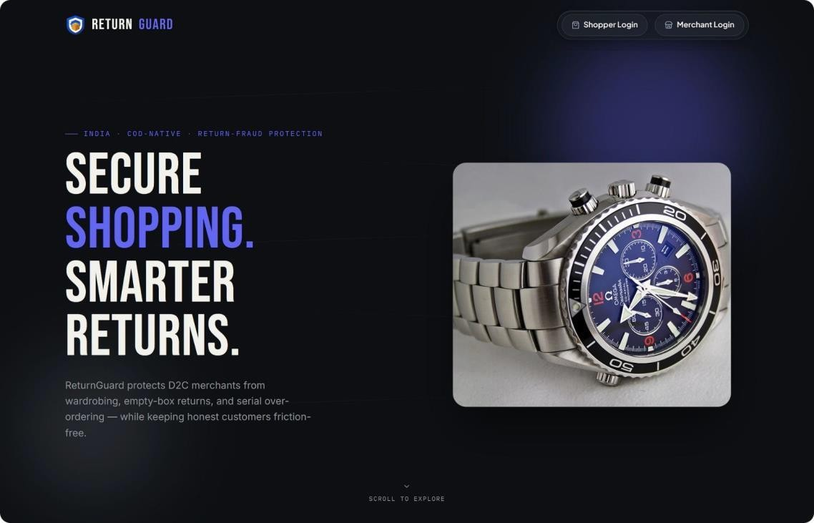
PROJECT OVERVIEW
Return Guard is an intelligent return-fraud detection system for Indian D2C e-commerce.
It provides Shopper and Merchant portals to manage orders, returns, and fraud investigation.
A real-time 0–100 risk engine evaluates orders and return claims.
It helps reduce return fraud, control logistics costs, and protect merchant profits while keeping genuine customers’ experience smooth.
SECURE SHOPPING. SMARTER RETURNS.

Slide 3
CHALLENGES & SOLUTIONS
1
Wardrobing & Festive Rental Abuse
Premium apparel worn once, returned for full refund.
Fix: Seasonal risk tightening + tag-intact checks
2
Size-Bracketing Multi-Orders
3–4 sizes ordered, only one kept — freight cost triples.
Fix: Cart-level detection + exchange incentives
3
4
Courier & Driver Collusion
Drivers falsely mark items rejected or siphon returns.
Fix: Geo-stamped signatures + route analytics
Electronics Hardware Swapping
High-value returns come back with parts missing or swapped.
Fix: Serial/IMEI verification + auto risk flag

Slide 4
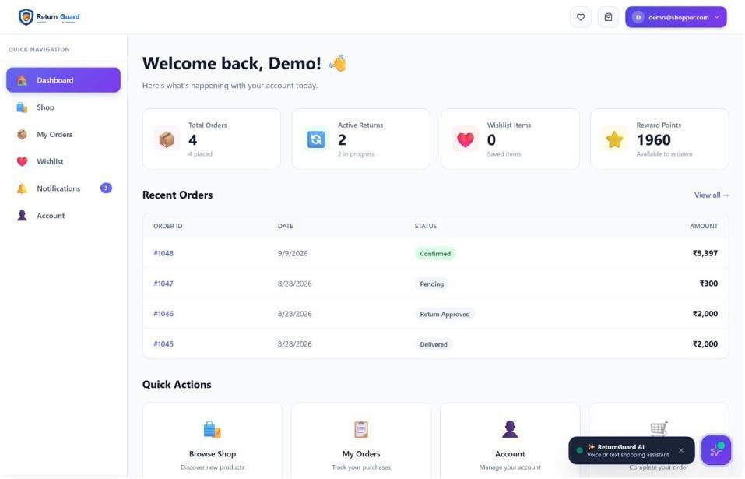
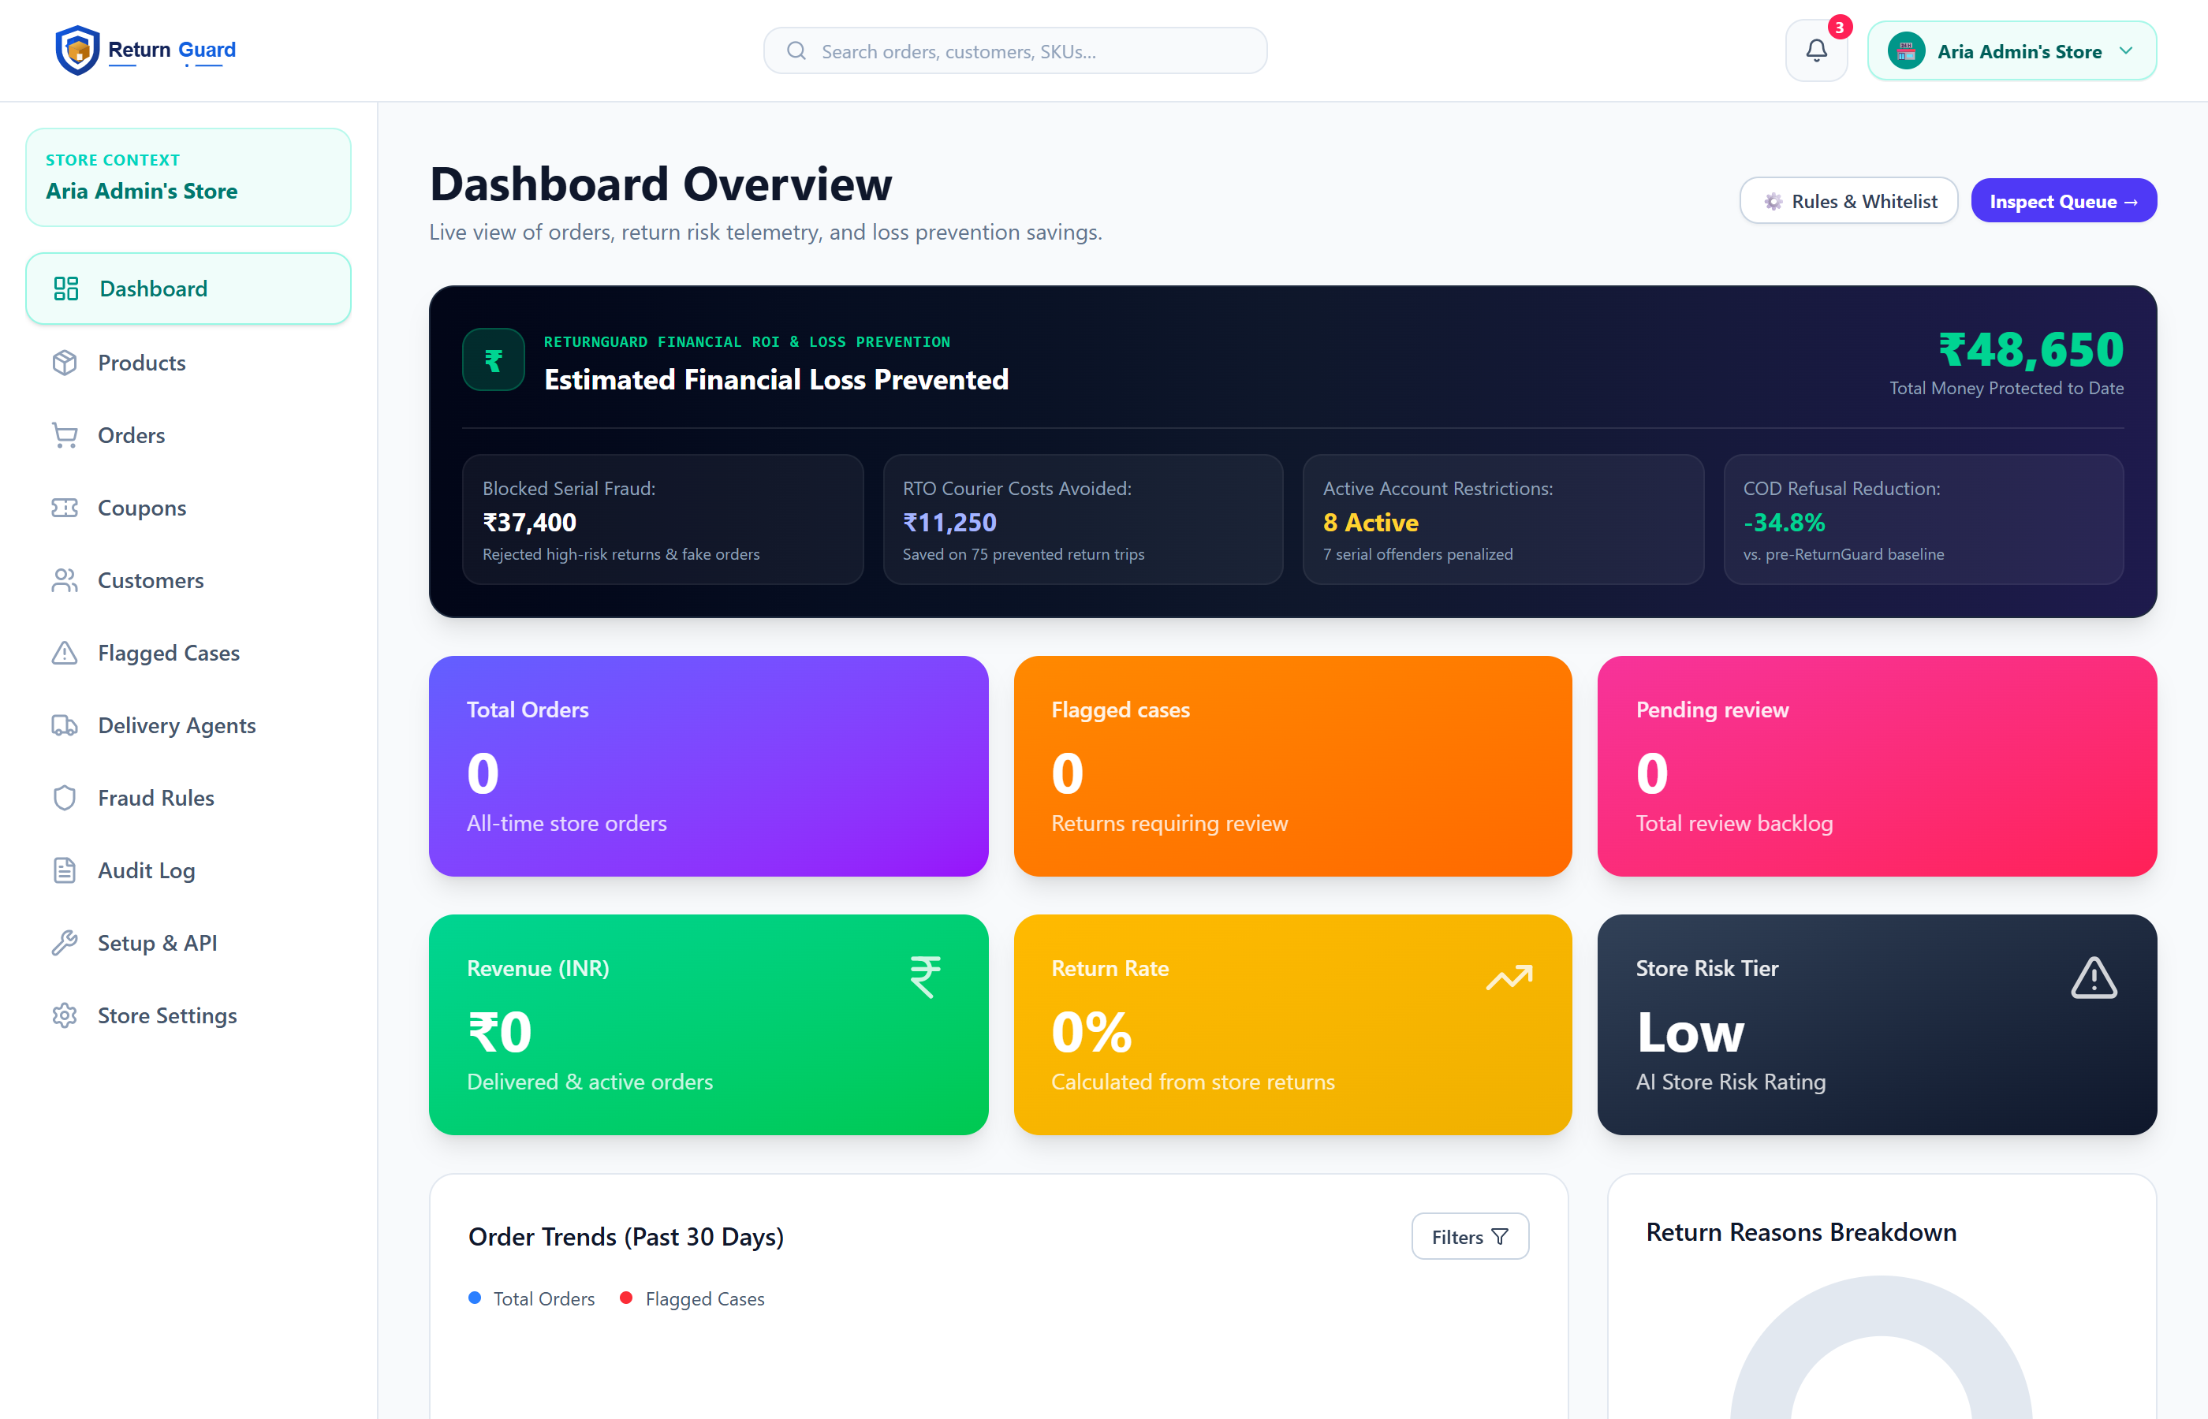
SHOPPER & MERCHANT DASHBOARDS
SHOPPER PORTAL MERCHANT PORTAL
1-click return & exchange from order history
Smart prompts favor exchanges over cash refunds
Live tracking from pickup to refund
85%+ get instant, friction-free approval
Real-time KPIs: return rate, loss prevented, risk tiers
Auto-triage routes risky claims to a review queue
Fraud-sensitivity sliders, tuned per category
Doorstep witnessing & courier handover tracking

Slide 5

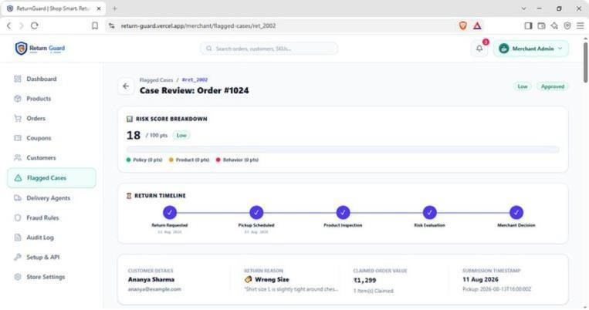
KEY FEATURES
Multi-Signal ,28-Checkpoint Risk Engine
Pre-Order Bracketing & Wardrobing Guard
Forensic Visual Proof & Serial Verification
5-Step Progressive Escalation Ladder
Delivery Agent & Courier Telemetry
REQUEST
PICKUP
INSPECTION
SCORE
Decision

Slide 6
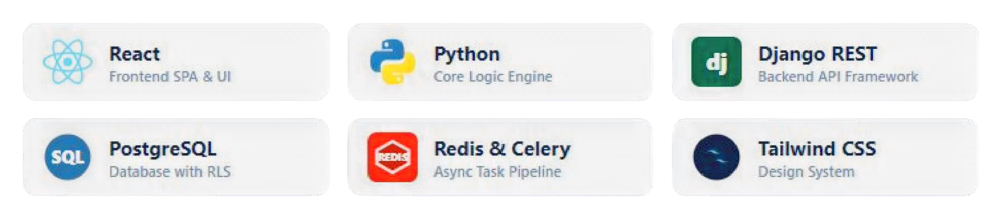
TECHNOLOGY STACK
FRONTEND & CLIENT
React + Vite SPA with hot module reload
Tailwind CSS
Lucide icons + Context API state
Axios client with JWT auto-refresh
BACKEND & DATA
Django REST Framework, sub-second scoring
PostgreSQL with row-level security
Redis + Celery async pipeline
HMAC-signed webhooks, PDF invoicing

Slide 7
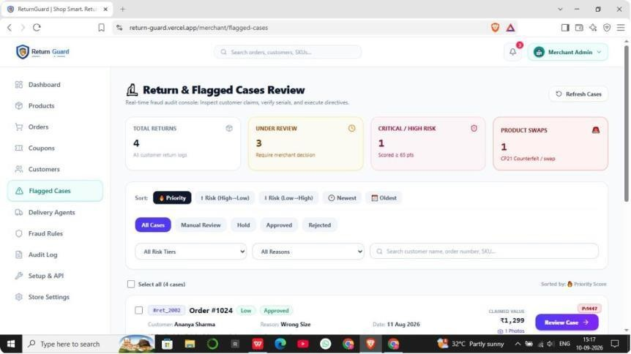
CONCLUSION
Massive Loss Prevention: Reduces fraudulent return losses by up to 35–40% without hurting sales conversion.
Fairness Through Progressive Policy: Protects customer retention by graduating penalties rather than enforcing harsh bans.
Scalable Modern Architecture: Built with high-performance React + Vite and Django REST Framework, ready for enterprise integration
BUSINESS VALUE
85%+
Instant approvals
for genuine shoppers
70%
Cut in wardrobing
& rental abuse
3x
Reverse freight cost
recovered
Protects merchant margin while keeping COD safe to offer.

Slide 8
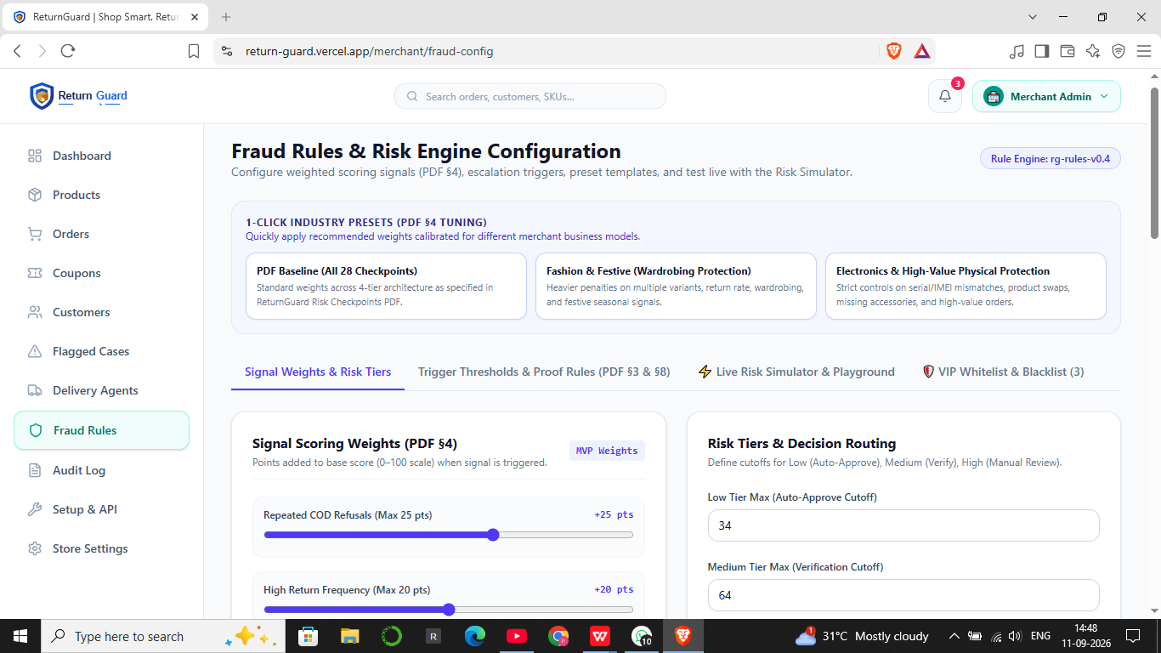
UNIQUENESS
Dual-Sided Balanced Ecosystem:
Protects merchant profit margins while rewarding verified low-risk shoppers with instant, frictionless refunds.
Pre-Dispatch Interception:
Stops wardrobing and size-bracketing before shipping costs are incurred, saving significant two-way freight expenses.
Separation of Courier vs. Buyer Fraud:
Uses Doorstep OTP and pickup timestamp telemetry, ensuring honest buyers are never penalized for courier pilferage.
100% Transparent & Dispute-Proof:
Every automated flag, merchant override, and policy directive is recorded in an Immutable Audit Log for dispute resolution.

Slide 9
FUTURE SCOPE
1
2
Mobile Edge Computer Vision
On-device AI scans fabric texture and tag integrity at the doorstep.
Consortium Fraud Graph
Privacy-preserving network flags serial fraudsters across merchants.
3
4
UPI Penny-Drop Refunds
Automated bank verification and split refunds via ₹1 UPI drops.
Chrome Ops Extension
Risk badges & 1-click triage inside Shopify, WooCommerce, Magento.

Slide 10

THANK YOU

